Slide 1
Fundamentals of git and GitHub
SERC Data Science Series
Abby Lewis
17 June 2025

Slide 2
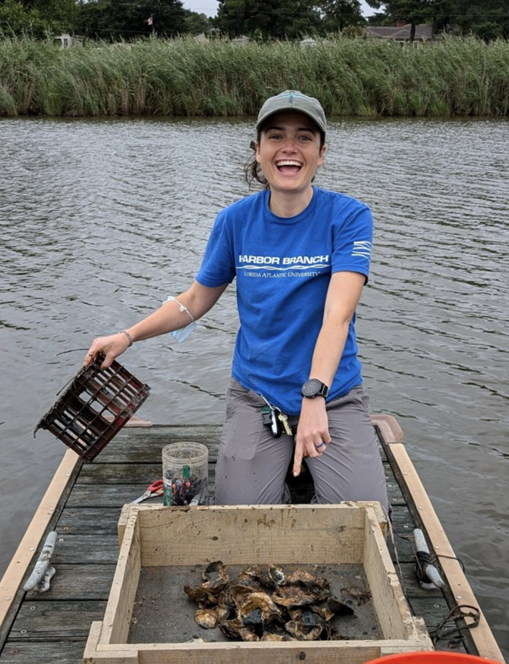
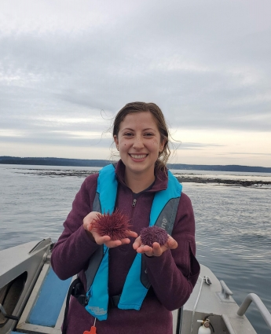


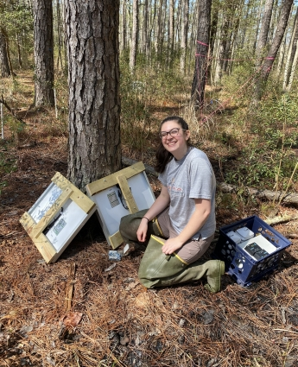
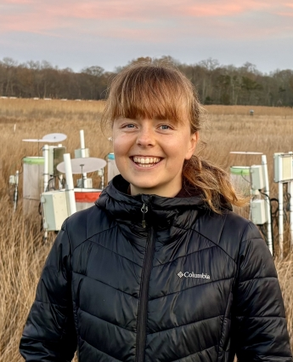
Summer Data Science Series
Sarah Goodnight
Mary Cortese
Michael Lonneman
June 17: Fundamentals of Git and GitHub
July 1: Intro to R Shiny
Michael Lonneman
July 15: Geospatial part 1
Mary Cortese
July 29: Geospatial part 2
Mary Cortese
August 12: Advanced data visualization and reports
Jaxine Wolfe
Jaxine Wolfe
Rose Cheney
Abby Lewis

Slide 3

version control
collaboration
backups
reproducibility

Slide 4
Objectives
By the end of the workshop, you will be able to:
Understand and execute a foundational GitHub workflow (pull, commit, push)
Understand the difference between a fork and a branch, and how these both help avoid potential issues in code
Use tools for documentation and collaboration (e.g., README.md files, GitHub issues)

Slide 5
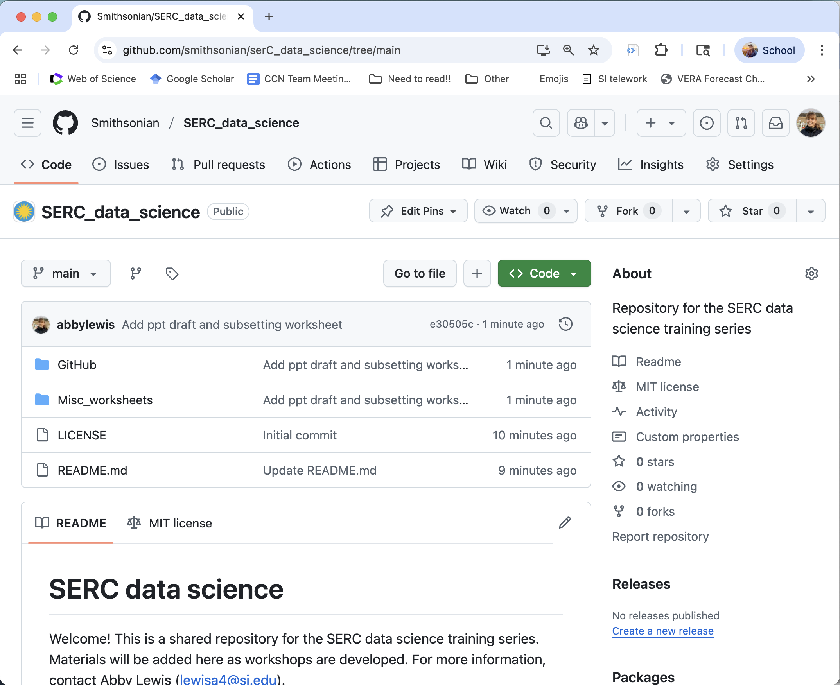

Slide 6



GitHub = service on the web
LOCAL
REMOTE

Slide 7

“repository”
“repo”
LOCAL
REMOTE

Slide 8
“repository”
clone
LOCAL
REMOTE

Slide 9
git pull
“repository”
LOCAL
REMOTE

Slide 10
git pull
“repository”
git commit
LOCAL
REMOTE

Slide 11

git pull
“repository”
git commit (again)
LOCAL
REMOTE

Slide 12
git pull
“repository”
git push
git commit
LOCAL
REMOTE

Slide 13
“repository”
(including commit history)
git pull
git push
git commit
LOCAL
REMOTE

Slide 14
REMOTE
“repository”
(including commit history)
LOCAL1
LOCAL2

Slide 16
Benefits of this workflow
For you:
Version control (commits = “checkpoints”)
Commit titles provide documentation
Back up your work!
Enables collaboration

Slide 17
Let’s try it!
Make a new repository in GitHub desktop
Publish to GitHub.com
Look at the repository on the web
Edit README.md
git commit
git fetch

Slide 18
Fork repositories to make a personal copy
smithsonian/SERC_data_science
Repositories stored in the Smithsonian
institutional account
Repositories stored on my GitHub account

Slide 19

Fork repositories to make a personal copy
“upstream”
fork
1
smithsonian/SERC_data_science
abbylewis/SERC_data_science
Repositories stored in the Smithsonian
institutional account
Repositories stored on my GitHub account

Slide 20
Fork repositories to make a personal copy
“upstream”
fork
1

Slide 21
http://github.com/smithsonian/SERC_data_science/

Slide 22


“Pull request” to contribute your changes
“upstream”
fork
1
merge “pull request”

Slide 23
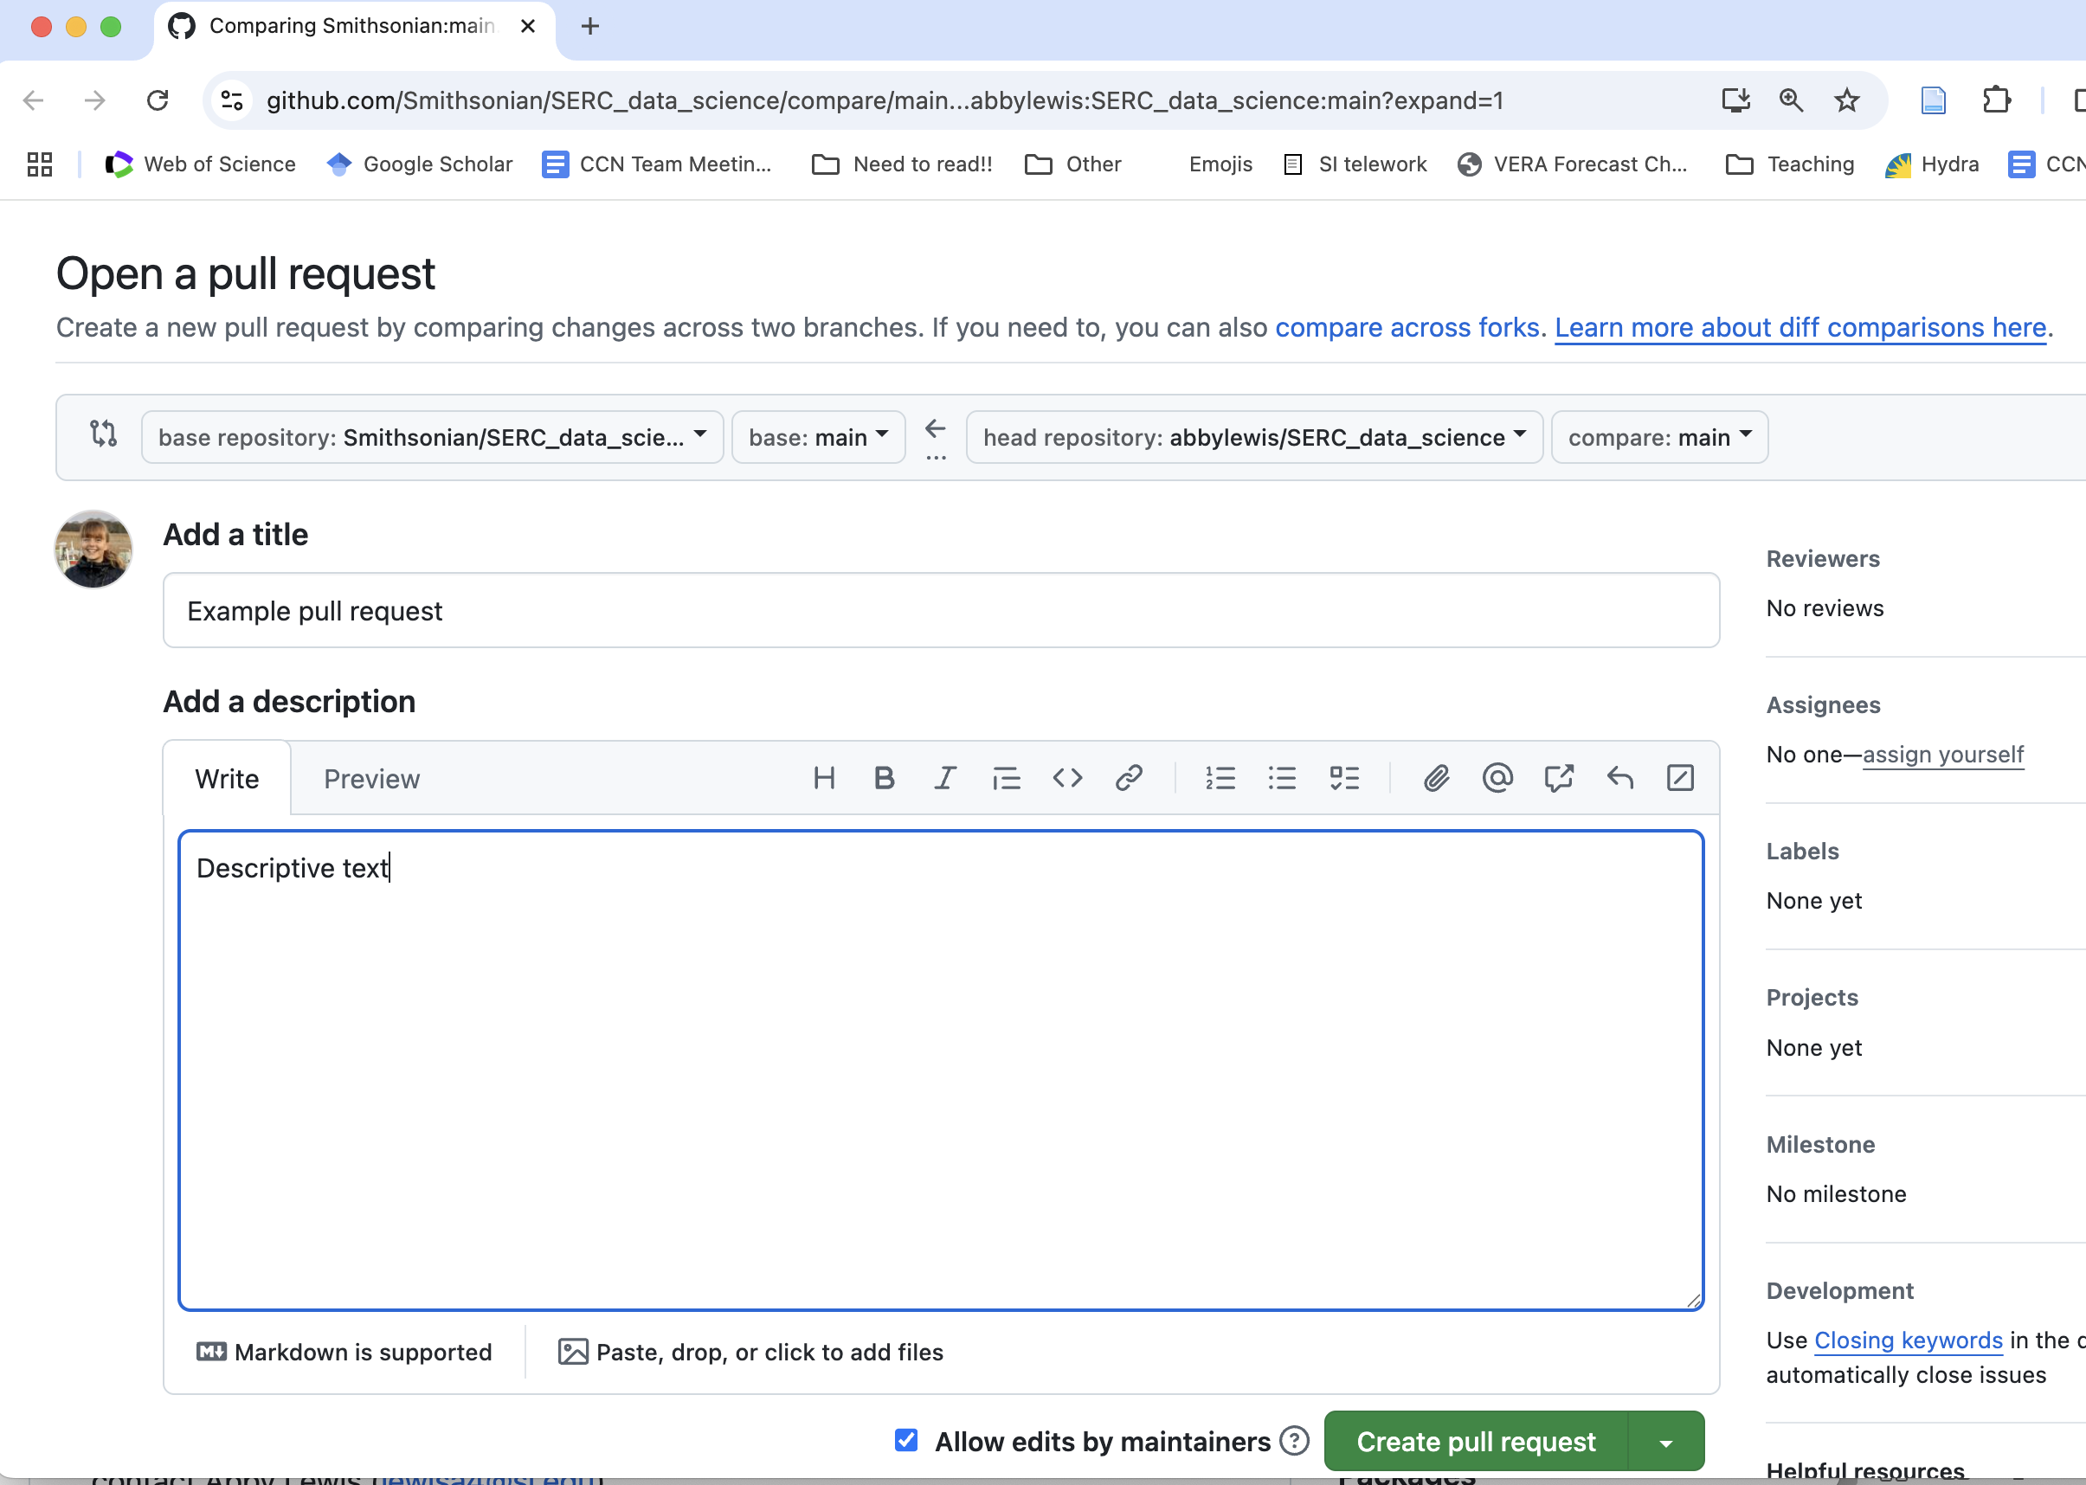

Slide 24
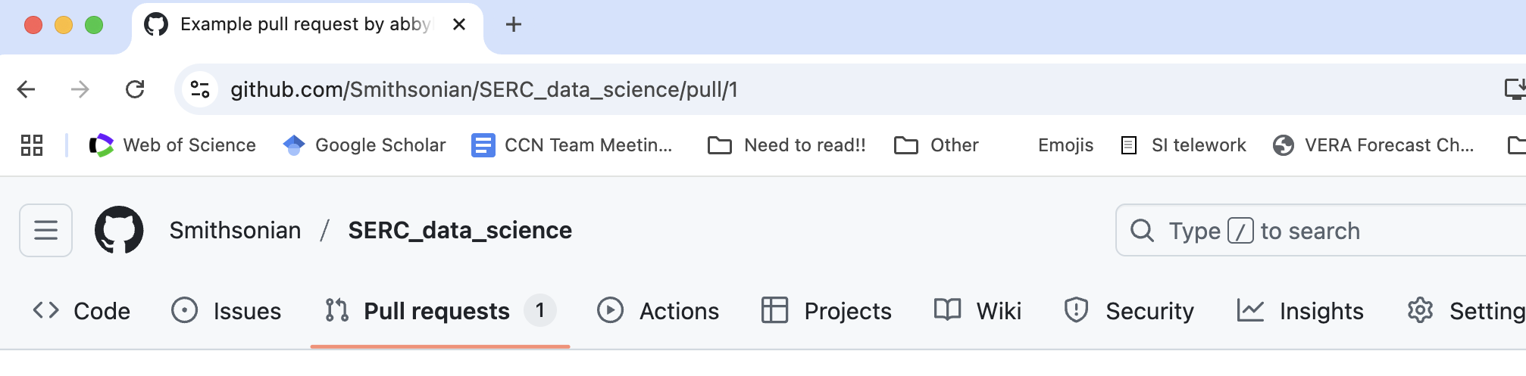
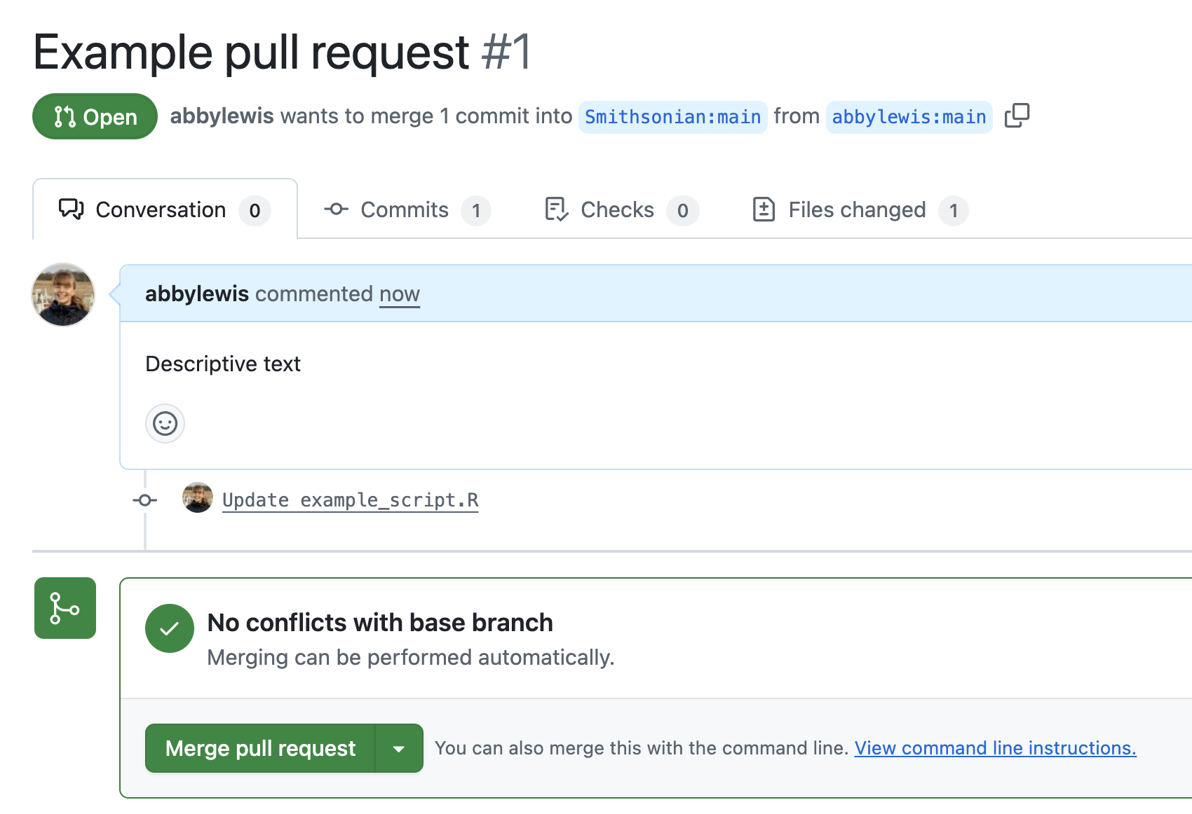

Slide 25
Degrees of separation: local/remote vs. forks vs. branches

Slide 26
Degrees of separation: local/remote vs. forks vs. branches
merge “pull request”

Slide 27
“Branches” provide an intermediate level of separation
repository
This exists as part of the repository on BOTH the local and remote versions
Notes:
Could be two different people

Slide 28
“Branches” provide an intermediate level of separation
repository
“main” branch
This exists as part of the repository on BOTH the local and remote versions
Notes:
Could be two different people

Slide 29
“Branches” provide an intermediate level of separation
“development” branches
branch
repository
“main” branch
This exists as part of the repository on BOTH the local and remote versions
Notes:
Could be two different people

Slide 30
“Branches” provide an intermediate level of separation
“development” branches
branch
merge/pull request
repository
“main” branch
“main” branch
This exists as part of the repository on BOTH the local and remote versions
Notes:
Could be two different people

Slide 31
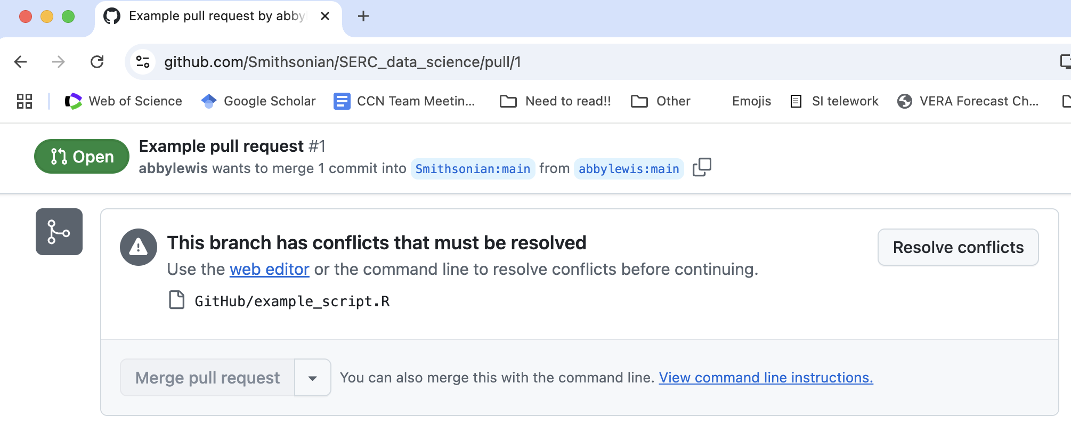
Merge conflicts
How to avoid
Communicate with team about who is working on what and when
Save/push your changes at appropriate times
Use branches and forks
Notes:
https://github.com/Smithsonian/SERC_data_science/pull/1/conflicts

Slide 32
Potential/sample workflows
Basic backup and archiving
E.g., you are working on an independent data analysis project
You decide to use one branch (main)
You commit changes locally every ~hour when coding
You push those commits to GitHub every day
Collaborative development
E.g., a team collaboratively developing new data processing scripts
Team members make new branches when they start a new task
They make commits on their local branch every ~hour, and push them to GitHub every day
They merge branches to “main” when the task is complete

Slide 33
Potential/sample workflows
Code re-use
E.g., I find a template GitHub repository with resources for making my own website
I fork that repository, then modify the scripts in the repository to customize my website
Collaborative development (external)
E.g., I find a bug in an R package and want to suggest a change
I fork the repository for that package and make a new development branch
I make edits to that branch by making local commits and pushing them to GitHub
I submit a pull request suggesting that the developers incorporate my changes

Slide 34
Collaboration and documentation
Issues
Assign (@, which you can do in commit too)
https://github.com/ikatyang/emoji-cheat-sheet/blob/master/README.md
Can add issue # to commit
What goes on github?
Code
Data? Not massive files
Think carefully about pushing figures, powerpoints, etc
Are there other places these should go?

Slide 35
Resources
https://docs.github.com/en
https://skills.github.com/

